Slide 1
Compare & Contrast DCVS Tools (Git & Mercurial)
By Kwen Peterson Twitter: @kwenarik Email: kwen.peterson@gmail.com
Raven Industries

Slide 2
Centralized vs. Distributed
No single point of failure
120 hour work package. How do you handle?
Code Reviews, sharing changes, patches

Slide 3
Comparison
git
Mercurial
Most popular, widely supported (github, TFS)
Reflog (time machine)
Meta-data light commits
Branches are nothing but pointers to the tip commit
Historically had better GUI clients for Windows (I would contest this at this point)
“SVN mode by default”
Rebasing, Bookmarks, etc. are all optional extensions you have to enable
Highly extendible via addins
Meta-data heavy commits

Slide 4
Clients
git
Mercurial
Git Extensions (VS integration)
SourceTree (Mac, in beta on Windows)
Microsoft Git Provider (VS plugin)
Git Source Control Provider (VS plugin)
Posh-git (PowerShell git bash)
TortoiseGit (don’t use this!)
TortoiseHg
VisualHg (VS plugin)
SourceTree (Mac, Windows eventually)

Slide 5
Pain points for Mercurial
Python conflicts!
Multiple side-by-side installs of Python
Build from source
Very limited “by default”
Majority of “git-like” features come from extensions
Usually not quite as easy to use as git equivalent (see squash…), or don’t exist (reflog)

Slide 6
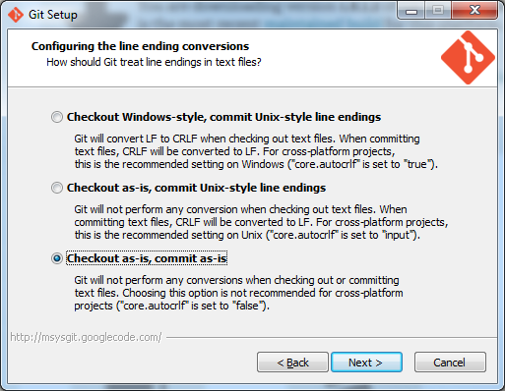
Pain points for Git
“I don’t like command-line.”
47 different ways to do the same thing
pull vs. fetch + merge/rebase, branch + checkout vs. checkout-b
Line Endings!
Windows
Unix
“Leave them alone”

Slide 7
Git Trivia
Git push origin master:master
Git push origin +master:master
Git push origin –f master:master

Slide 8
What did Kiln Harmony teach us?
“…you can end up with (Mercurial) repositories you can convert to Git, but that you cannot convert back to Mercurial.”
Git timezones are not always valid.
Git/Hg handle endlines differently.
Git has authors & committers: Hg has username

Slide 9
Common git branching strategy
3 core branches: master, dev, release
Master is “the truth” and should always be a in a stable, fully-functional state. This is where new topic (work package) branches are cloned from.
Dev is where integration testing happens. This is where topic branches are pushed and tested PRIOR to being signed off on as stable enough to go to master. (This is what you point your continuous integration at.)
Release is where the last live build lives. This exists so that if an absolutely critical issue arises, we can make the fix here and release the build, being confident that the ONLY change going out is the critical bug fix.

Slide 10
Rebase vs. Merge
http://www.slideshare.net/lemiorhan/git-branching-model?utm_source=slideshow&utm_medium=ssemail&utm_campaign=weekly_digest

Slide 11
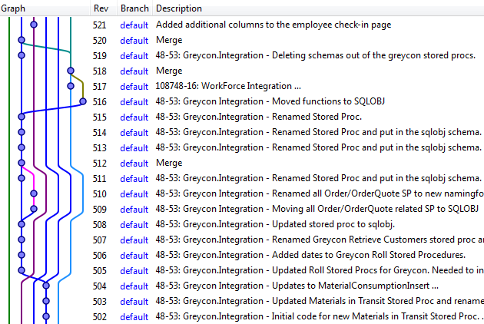
Commit graph (merge)

Slide 12
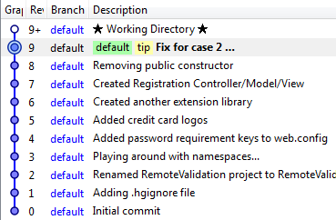
Commit graph (rebase)

Slide 13
Interactive Rebase
Git
git rebase –i HEAD~3
Mercurial
Plugin: HistEdit Extension
http://mercurial.selenic.com/wiki/HisteditExtension

Slide 14
Git Squash
git rebase –i HEAD~3
pick f392171 Added new feature X
pick ba9dd9a Added new elements to page design
pick df71a27 Updated CSS for new elements
Change to:
pick f392171 Added new feature X
squash ba9dd9a Added new elements to page design
squash df71a27 Updated CSS for new elements

Slide 15
Mercurial Squash
Enable the mq extension (mercurial queues)
Set diffs to git style
Commandline: (11 commands!)
hg clone base working # tip of base is revision 73
cd working # do work, committing on the way
cd ..
hg clone working squash
cd squash
hg qimport -r 74:tip
hg qgoto 74.diff
hg qfold $(hg qunapp)
hg qfinish –a
cd ../base
hg pull ../squash

Slide 16
Time Machine!
Git reflog
Git reset –hard <hash>

Slide 17
Command Equivalence Cheat Sheet
Hg command | Git command | Notes
Hg pull –u | Git pull | Shorthand for fetch + merge. (Nathan method)
 | Git pull --rebase | Shorthand for fetch + rebase. (Kwen method)
Hg pull | Git fetch | Get changes, but don’t apply
Hg clone <path> <name> | Git clone <path> <name>
Hg push | Git push <local>:<remote>
Hg add | Git add
Hg merge | Git merge <branch>
Hg rebase –d <changeset> | Git rebase <branch>
Hg status | Git status
Hg transplant <cset> Hg graft <changeset> | Git cherry-pick <commit>

Slide 18
Resources
Recommended
http://rogerdudler.github.io/git-guide/
http://www.slideshare.net/lemiorhan/git-branching-model?utm_source=slideshow&utm_medium=ssemail&utm_campaign=weekly_digest
Git ~ Hg Cheat Sheets
http://mercurial.selenic.com/wiki/GitConcepts *
http://jgrasstechtips.blogspot.com/2011/03/mercurial-and-git-cheatsheet.html
http://hyperpolyglot.org/version-control
http://blogs.atlassian.com/2012/02/mercurial-vs-git-why-mercurial/?s
https://github.com/sympy/sympy/wiki/Git-hg-rosetta-stone/eb04a48a4830c1cb71fd04a56e8aaf8b4517329c
Git Clients
https://code.google.com/p/gitextensions/
http://sourcetreeapp.com/
https://github.com/dahlbyk/posh-git
Kiln Blog: http://blog.fogcreek.com/kiln-harmony-internals-the-basics/
Mercurial Squash: http://martinfowler.com/bliki/MercurialSquashCommit.html

